Slide 1
Prediction of Lithium-Ion Battery Cycle Life by Machine Learning Methods
Undergraduate Project
Parthapratim Chatterjee
Materials Science and Engineering
210705

Slide 2
Introduction
For a lithium-ion battery, its cycle life is defined as the number of full charge cycles that a battery can undergo until its full charge capacity falls below 80% of the design capacity.
Lithium-ion battery is the most common type of rechargeable batteries in portable electronics, electric vehicles, military/space applications.
Degradation of the performance of a battery can be observed over time to predict when the performance of the battery will become below standard, which can be regarded as a battery failure.
The industry standard defines a quantitative term, “cycle life”, to quantify the number of full charge cycles a battery can undergo until the full charge capacity of battery falls below 80% of its design capacity.

Slide 3
Data Description
The entire dataset is available in the github repository, Dataset.
This dataset contains information about commercial grade Lithium Iron Phosphate (LiFePO) cells.
There are 3 test batches (each of them was tested on a different date) with 41, 43 and 40 battery cells (a total of 124) in each batch, respectively.
All cells were charge-discharge cycled in a temperature-controlled chamber with various fast charging conditions, starting from 3.6 C to 6 C, which was deemed to be an extreme fast charging condition.

Slide 4
Data Description
The descriptions of some charging variables included in the dataset are given below:
cycle-life: the number of full charge cycles that a battery can undergo until the full charge capacity of the battery falls below 80% of its design capacity.
charge-policy: “C1-Q1-C2” - C1 and C2 represent the first and second applied current in amount of coulomb of charge flow per second, and Q1 is the percentage state-of-charge (SOC) at which the current is changed from C1 to C2. C2 charge is applied till to 80% SOC. After that, all batteries are charged in the same way: at 1 C of constant current till to 3.6 V, and then at a constant voltage of 3.6 V.

Slide 5
Dataset Description
Summary of Cycles:
(a) IR: internal resistance of the battery in each full charge cycle.
(b) QC: charge capacity of the battery after a full charge cycle.
(c) QD: discharge capacity of the battery after a full charge cycle. (d) Tavg: average temperature of the battery during a full charge cycle.
(e) Tmin: minimum temperature of the battery during a full charge cycle.
(f) Tmax: maximum temperature of the battery during a full charge cycle.
(g) chargetime: time to charge the battery in a full charge cycle.

Slide 6
Dataset Description
cycle data (for each full charge cycle)
(a) I: current monitored over time.
(b) Qc: charge capacity of the battery over time
(c) Qd: discharge capacity of the battery over time
(d) T: temperature of the battery over time
(e) V: voltage (potential) of the battery over time

Slide 7
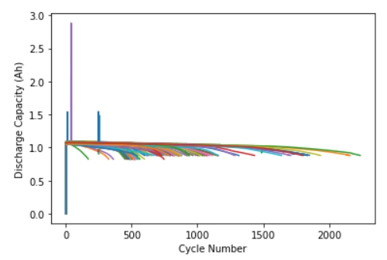
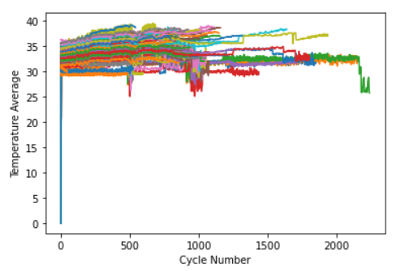
Dataset Plots of a Particular Cell

Slide 8
Data Extraction
1)Extracted data from a nested dictionary, analyzing key parameters for all features including:
Internal resistance
Charge capacity
Discharge capacity
Average temperature (Tavg)
Minimum temperature (Tmin)
Maximum temperature (Tmax)
Chargetime
The mean, variance, and maximum was calculated for the above-mentioned parameters.
Additionally collected time-series data for monitored parameters: Current (I) Charge capacity (Qc) Discharge capacity (Qd) Temperature (T) Voltage (V) Computed the mean values across all features for the initial 100 cycles within the dataset. Compiled a comprehensive dataset comprising 31 columns and 124 rows, providing detailed insights into the system's performance and dynamics.

Slide 9
MODELS USED FOR TRAINING

Slide 10
Support Vector Regression
Data Loading and Preprocessing:
Loaded data from a CSV file into a Pandas DataFrame.
Selected feature columns and defined the target variable.
Split the dataset into training and testing sets.
Feature Scaling:
Utilized StandardScaler to scale the feature variables for better model performance.
Model Training and Evaluation:
Employed Support Vector Regression (SVR) with a linear kernel.
Trained the SVR model on the training data.
Made predictions on the test set and evaluated performance using Root Mean Squared Error (RMSE).

Slide 11
Support Vector Regression
Hyperparameter Tuning with Grid Search:
Conducted hyperparameter tuning using GridSearchCV to optimize model performance.
Defined a parameter grid including regularization parameter (C), kernel type, gamma, and epsilon.
Utilized 5-fold cross-validation for model evaluation.
Identified the best combination of hyperparameters and the best estimator using the grid search.
Model Evaluation with Tuned Hyperparameters:
Utilized the best estimator obtained from the grid search to make predictions on the test set.
Evaluated the performance of the tuned model using RMSE.
Results:
Root Mean Squared Error (RMSE) was used as the evaluation metric.
Compared the RMSE obtained from the initial SVR model with the one obtained after hyperparameter tuning using Grid Search and Cross-Validation.

Slide 12
Deep Neural Network
Data Loading and Preprocessing:
Loaded data from a CSV file into a Pandas DataFrame.
Specified the target column, which in this case is 'Cycle’.
Removed the 'Cell' column from the dataset to avoid multicollinearity issues.
Feature Scaling:
Utilized StandardScaler to scale the feature variables for better convergence during training.
Building the Deep Neural Network (DNN) Model:
Constructed a Sequential model using TensorFlow's Keras API.
Added multiple Dense layers with varying numbers of neurons and activation functions.
Incorporated Dropout layers to prevent overfitting by randomly dropping a fraction of input units during training.

Slide 13
Deep Neural Network
Model Compilation and Training:
Compiled the model with Adam optimizer and mean squared error loss function.
Trained the model on the training data for 250 epochs with a batch size of 10.
Specified a validation split of 0.2 to monitor the model's performance on a validation set during training.
Model Evaluation:
Made predictions on the test set using the trained model.
Evaluated the model's performance using Root Mean Squared Error (RMSE) metric, comparing predicted values with actual values.
Visualizing Model Performance:
Plotted the training and validation RMSE over epochs to visualize the model's convergence and potential overfitting.

Slide 14
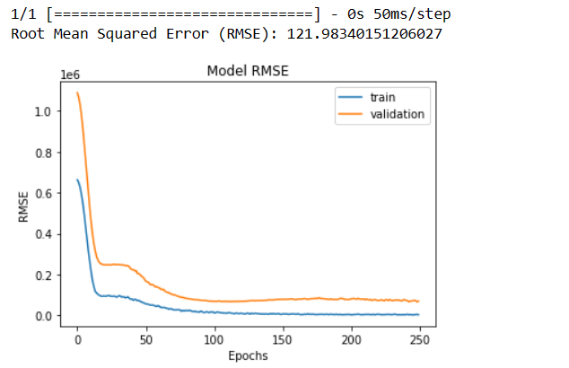
Result of Deep Nerural Network
Graph of RMSE vs Epochs

Slide 15
Elastic Net Regression
Data Loading and Preprocessing:
Data is loaded from a CSV file using Pandas.
Feature columns and the target variable are identified.
Feature Selection:
Columns like 'Cell' and 'Cycle' are identified and dropped as they are not considered as features for prediction.
Splitting Data:
The dataset is split into training and testing sets using train_test_split from Scikit-learn.
Feature Scaling:
StandardScaler is used to scale the features to have a mean of 0 and a standard deviation of 1.

Slide 16
Elastic Net Regression
Model Training:
An Elastic Net model is instantiated with specified values for hyperparameters alpha and l1_ratio.
The model is trained on the scaled training data using fit.
Model Evaluation:
Predictions are made on the scaled test set using the trained model.
The Root Mean Squared Error (RMSE) is calculated to evaluate the model's performance compared to the actual target values.

Slide 17
Results
Name of Model | RMSE | Percentage Error
Elastic Net Regression | 207.996 | 23.28%
Support Vector Regression | 215.432 | 24.59%
Deep Neural Network | 121.983 | 17.14%

Slide 18
Conclusion
As shown in the results the three models were tried to predict the output of cycle life of Lithium Batteries, we could see that the Deep Neural Network performs the best among the 3 models.
Since in the literature review there were many papers using SVR for the prediction, however looking into the deep neural networks for prediction could be a new way for prediction of battery cycle life.

Slide 19
THANK YOU

